Slide 1
ICT & Software Engineering
06 – Windows Forms APP
Multiforms & Debugging

Slide 2

Content
Topics of this lecture
Multiple forms
Random class
Debugging in Visual Studio

Slide 3
Windows forms App
Multiple Forms

Slide 4

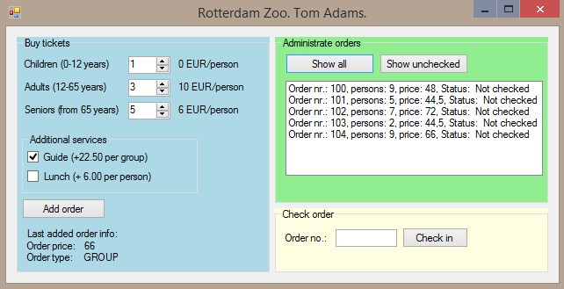
Intro
A Form is a class and as such can be instantiated as an object (e.g. new Form1())

Slide 5

Examples
The extra form
...
public partial class ChildForm : Form
{
public ChildForm() {
InitializeComponent();
}
private void btnClose_Click(object sender, EventArgs e) {
this.Close();
}
}
...
Creating and showing extra form
...
ChildForm cf = new ChildForm();
cf.Show();
...

Slide 6

Syntax
Creating the form object
<form class> <variable name> = new <form class>();
Showing the form object
<variable name>.Show();
Closing the form object
<variable name>.Close();
this.Close();

Slide 7
Examples
The extra form
...
public partial class ChildForm : Form
{
public ChildForm(string name) {
InitializeComponent();
this.Text = name;
}
}
...
Creating and showing extra form
...
ChildForm cf = new <???>;
cf.Show();
...

Slide 8

Demo
Form with detail form:
Clicking the ListBox will open new form

Slide 9

Questions?

Slide 10
Rolling a dice
Random class

Slide 11

Intro: Random
Some time things need to happen randomly. Like rolling a dice or picking a random person.
This can be achieved by generating a random number,
Hence, Random class

Slide 12
Syntax
Random randomNumber = new Random();
int generatedNumber;
// generates a non-negative integer; 0 or more
generatedNumber = randomNumber.Next();
// generates a non-negative integer less than 5; e.g. 0, 1, 2, 3 or 4
generatedNumber = randomNumber.Next(5);
// generates an integer in the range 5, 6, 7, 8, 9, 10, 11
generatedNumber = randomNumber.Next(5, 12);

Slide 13
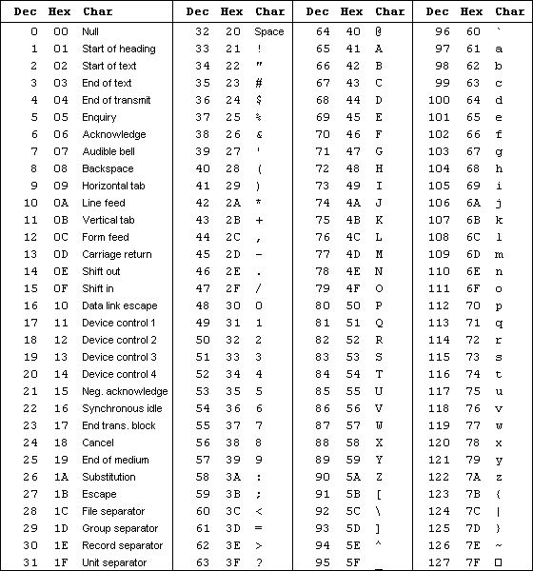
Demo
Create a random string generator
Using ASCII <-> int or
Using array

Slide 14

Extra information
Random-class is a pseudo random number generator (i.e. based on computer system clock)
It is best to create one object of class Random to generate random numbers

Slide 15
Questions?

Slide 16

What to do next?
Start working on the practcial

Slide 17
Part 2 – Practical
See canvas for practical assignments

Slide 18
Part 3
Debugging in visual studio

Slide 19
Questions about practical?

Slide 20
Content
Topics of this lecture
Multiple forms
Random class
Debugging (in Visual Studio)

Slide 21

Errors during programming pratice
What do you do when you have an error?

Slide 22
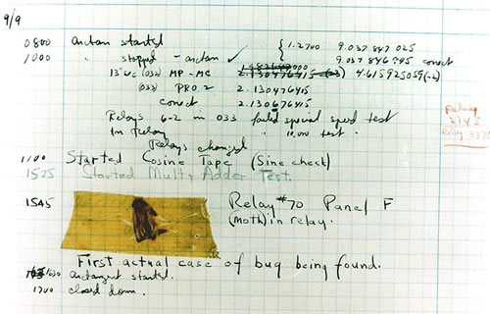
Debugging
(Find and) correct errors
First computer bug ever:
September 9, 1945, Harvard Mark II
Grace Hopper
Moth stuck between relays

Slide 23
Types of errors
Syntactical/Syntax
During compiling (or linking)
Runtime
Unanticipated error during execution of program
Logical
Program does something strange (incorrect behavior that doesn’t crash application)
Efficiency
Program uses unnecessary resource

Slide 24
Debugging process
Identify error
Isolate/find part of code
Correct error
Verify if the error is fixed and nothing else broke

Slide 25

‘Keep calm’
Debugging can be hard and usually requires experience & ‘feeling’
There might be no obvious ‘relation’/cause:
Only specific situations
Not caused by your code
Human errors

Slide 26

General advise
Try to understand what is happening
‘It builds’ != ‘It works’!
Don’t always trust:
Error messages
Documentation
Environment differences

Slide 27

Basic debugging techniques
Logical reasoning
Use print statements
Simulate by hand
Skip code
If all else fail…

Slide 28
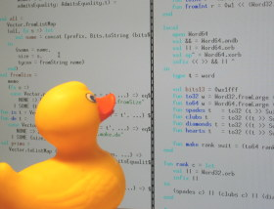
Rubber duck debugging
Rubber Duck Debugging (confessional debugging)
Obtain rubber duck
Place the duck on your desk
Explain in detail to the duck what each line of code does
At some point you realize that is not what you are doing
(The duck is happy it helped you)

Slide 29
IDE Debugging tools
IDEs, such as Visual Studio, have build-in tools to help you debug
Syntax errors
Visually represented & application will not run/compile
Runtime & logical errors
Debugger tool which allows you to:
Set breakpoints
Step through statements
Inspect values with watches
Look at call stack

Slide 30
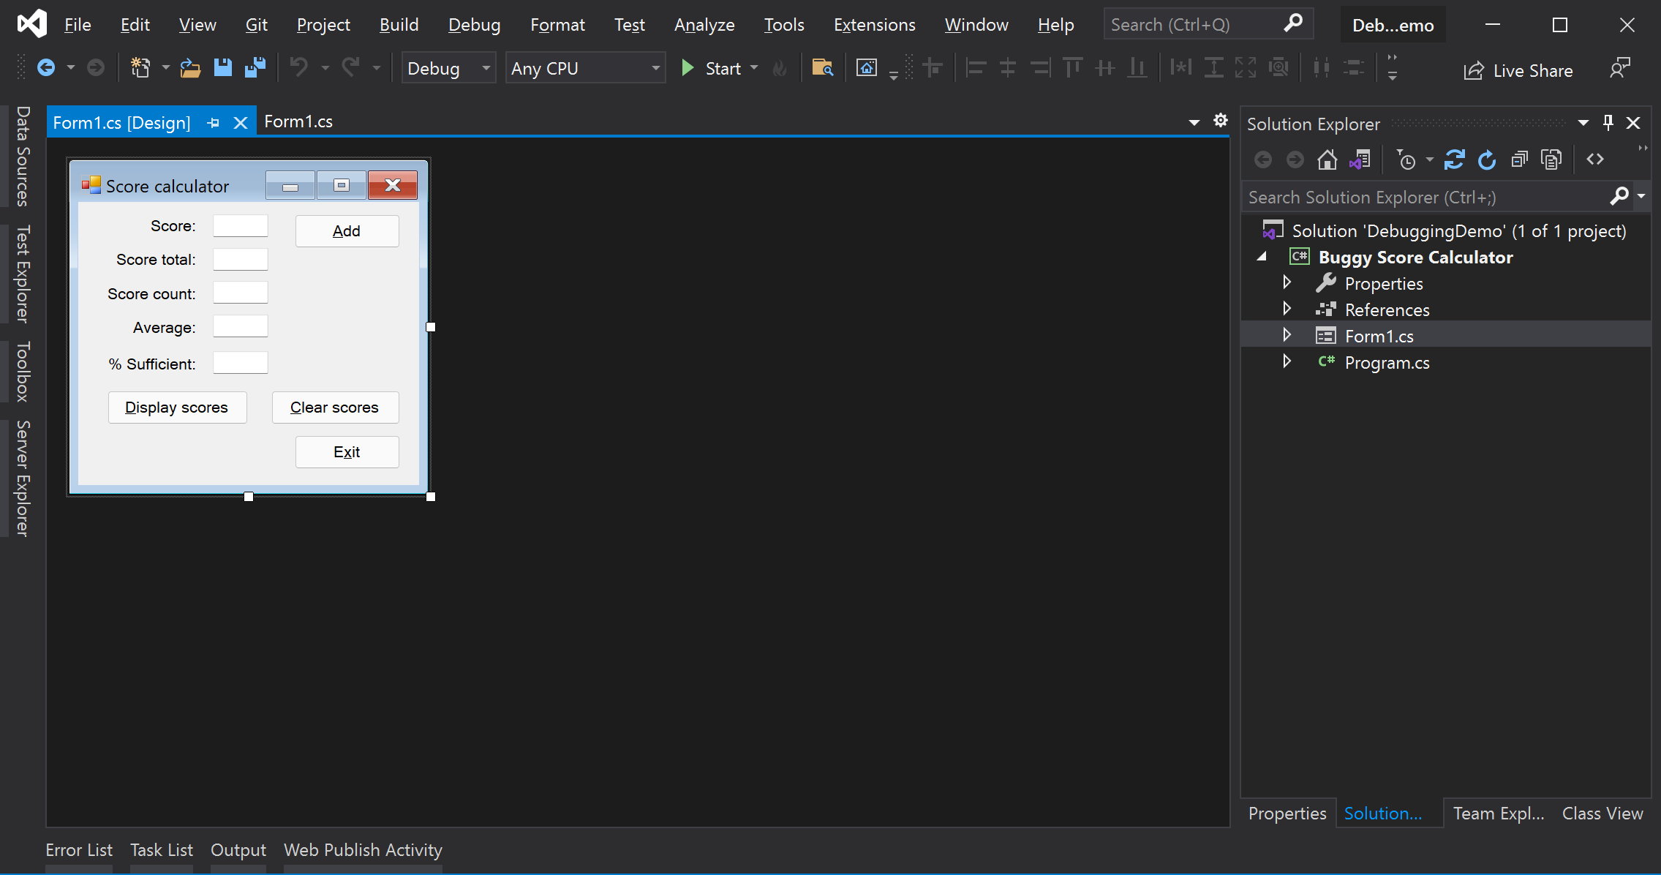
Demo: Fixing a buggy application

Slide 31
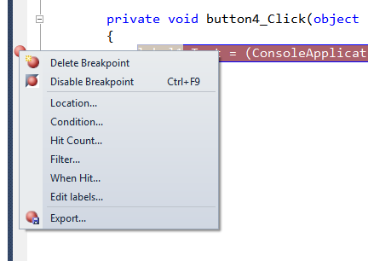
Visual studio: Breakpoints (1/2)
You can add a breakpoint at a line of code and here the application stops execution
In addition, there are also special options:
Stop when conditions are met
Stop after N passes
More…

Slide 32

Visual studio: Breakpoints (2/2)
After ‘hitting’ a break-point, you can:
Step Into (F11):
Go through each line one by one
Step Over (F10):
Finish current method-call; do not go into the method
Step Out (Shift + F11):
Finish current method

Slide 33
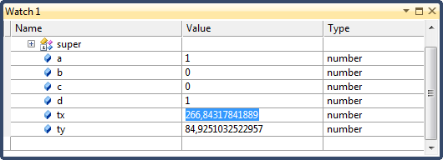
Visual studio: Watches
In the Watch panel you can see the value of a variable
You can also move you mouse over variable to see its current value

Slide 34
Other debugging tools
There are more tools for different types of testing
Profiler
Find out how long/often the program is executing certain pieces of code
Also for SQL
Tools that can find memory leaks
Stress testing
Etc.

Slide 35
What to do next?
Start working on the practcial

Slide 36

Summary
After this lecture you can:
You are able to make use of multiple forms
Introduce randomness in an application
You can make use of Visual Studio’s debugging tools

